Slide 1
Datafest
File created on: 5/15/2020 12:05:04 AM

Slide 2
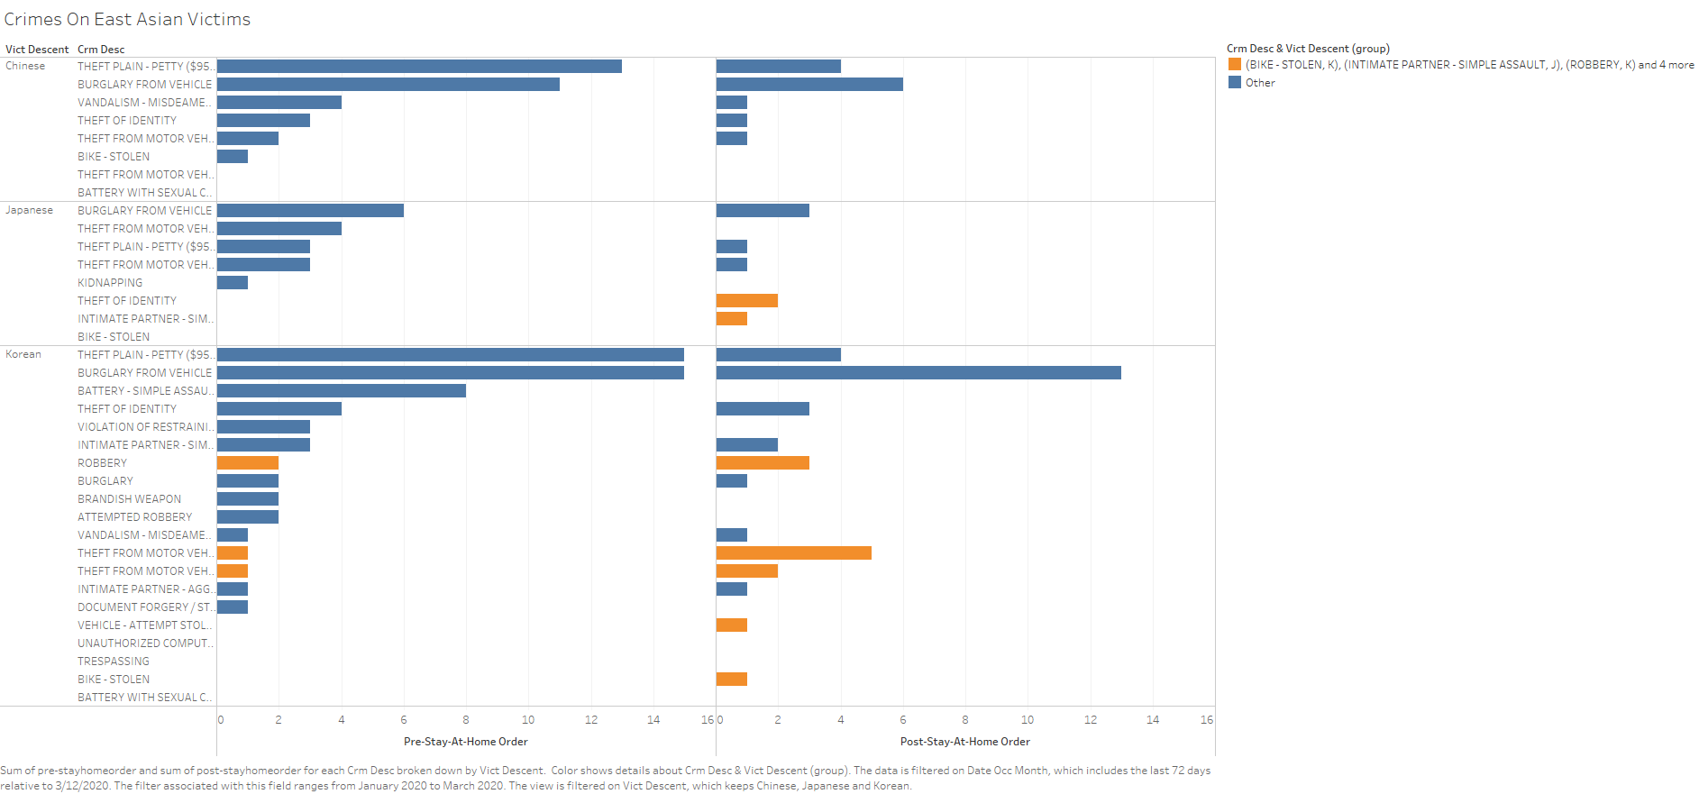

Slide 3
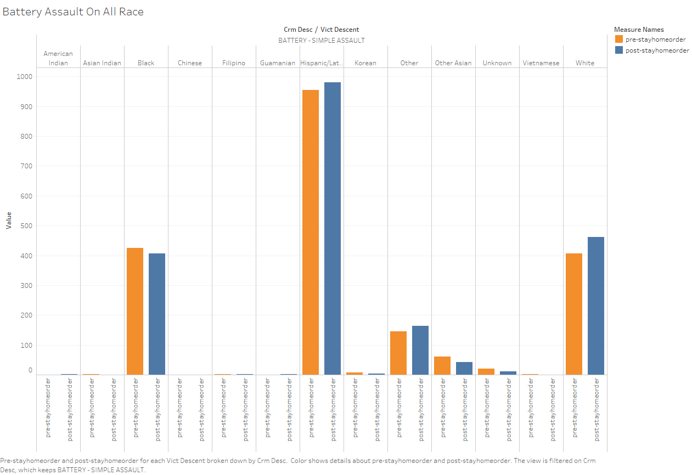

Slide 4
